Slide 1
Chapter 4 Classification
Dr. Dai Yu

Slide 2
Why Classify
Help for information retrieval
Documents with the same topics will be classified into one class.

Slide 3
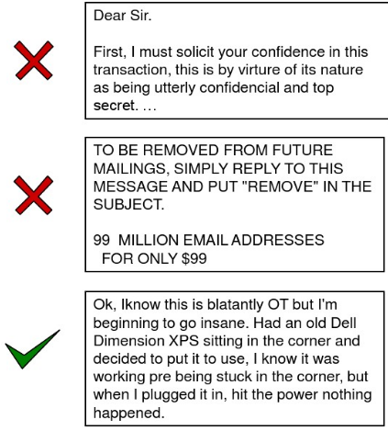
Example: Spam Filter
Input: email
Output: spam
Process
get a large collection of example emails, each labeled spam
someone has to hand label all this data
want to learn to predict labels of new, future emails
Feartures: the attributes used to make the spam decision
words: Free！

Slide 4
Training & Validation
Data: labeled instances, e.g. emails maked spam
Training
Estimate parameters
Tune parameters
Report results with over-optimization

Slide 5
Some State of the art classifiers
Support vector machine
Regression
Bayesian
Decision Tree and Random Forests

Slide 6
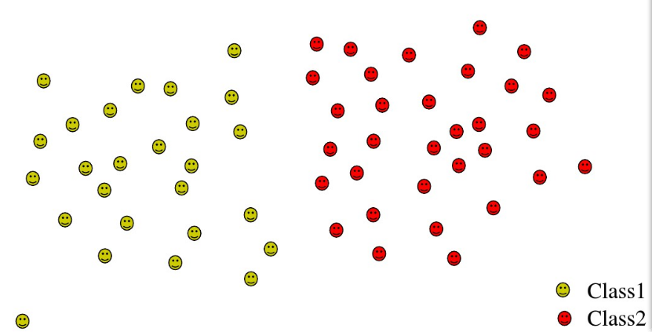
Intutitive Picture of Classification

Slide 7
How to Classify?
Example from the reality
How to know someone is sad?
How to know it is a cat?
How to differentiate a cat from a dog?
Lean by features.

Slide 8
What is feature?
Feature is an information about an object from some point of view.
Example
The shape of the eyes
The shape of the ears
The color of the eyes
The color of the face

Slide 9
Classify for the documents
A document can be expressed as a vector of the terms or words
Classify will be done on a set of documents, we mean, on a set of vectors
Similar documents may be classified into one category.
A document may contain a lot of words
The vector of a document may be a high dimention one.

Slide 10
Classify with the high dimension objects
High dimension may cause over-fitting
Example, ARACHNOCENTRIC wehter belong to China category
If in the training set, the occurence of ARACHNOCENTRIC always company with China
Then, the term will be classified to China

Slide 11
Feature Selection
Select the most important features which will affect the classified results
Factors to be considered:
frequency of the term
mutual information (information gain)
Chi-square

Slide 12

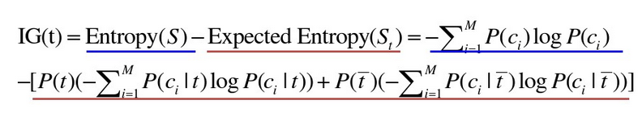
Mutual Information
A(t, c) is to compute the mutual information between the term t and the categoryc.
If the term does not affect the classification, then the mutual information will be low.
Also you can use entropy to compute.

Slide 13
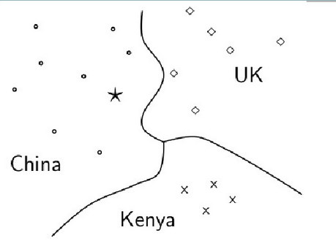
Classification

Slide 14
Method for Classification
Relevance Feedback
tag the document as relevance or non-revelance
Then, extract the feature value of the category based on the documents contained in it.
Turn the problem as an optimization problem.
To set the data points in order to make the overall distance between the points to the centroid of the category they belongs to the minimum.

Slide 15
Method for Classification
Linear Regression

Slide 16
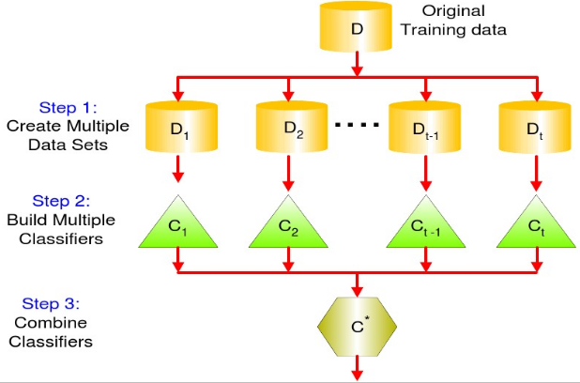
Composition of Classifiers

Slide 17
How to Compose?
Optimization
Learn

Slide 18
Example
“Take photoes and Gain” is a new service model. Users can download the APP and register. Then, the user can get the task from the APP such as take photoes of the commodities of some supermarket. Then, the user can be paid for this task. This kind of outsourcing platform can save the cost of the company to do the business investigation. But the pricing model of the platform is very important. If the price of the task is very low, then the user may not like to take this task.
Table 1 is a list of tasks which has been finished, including the location, pricie and the implement status of the task
Table 2 is about the user's information, include the location, reputation, the start time to book a task and the number limits of the task. The user with the high reputation has the opportunity to select the task early and the limits is big also.
Analyze why some tasks have not been finished.

Slide 19
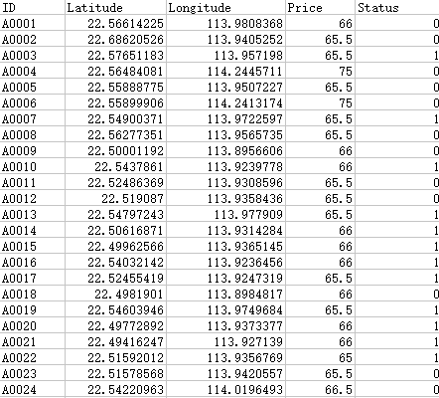
Data

Slide 20
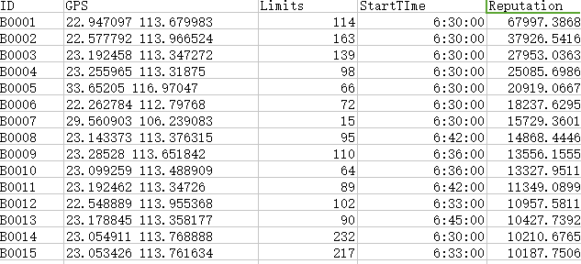
Data

Slide 21
What is the Proess to solve this problem?
Classify？

